Slide 1
Balance of Payments
Chapter 3

Slide 2
Overview
Balance of Payments Accounting
Balance of Payments Accounts
  The Current Account
  The Capital Account
  The Financial Account
  Statistical Discrepancy
  Official Reserves Account
The Balance of Payments Identity
Balance of Payments Trends in Major Countries
3-<number>

Slide 3
Balance of Payments Accounting
Balance of payments is the statistical record of a country’s international transactions over a certain period of time presented in the form of double-entry bookkeeping
Important to study for a few reasons:
  Provides detailed information concerning the demand and supply of a country’s currency
  May signal its potential as a business partner for the rest of the world
  Used to evaluate the performance of the country in international economic competition
3-<number>
Notes:
Examples of international transactions include import and export of goods and services and cross-border investments in businesses, bank accounts, bonds, stocks, and real estate.

Slide 4
Balance of Payments Accounting (Continued)
Any transaction that results in a receipt from foreigners will be recorded as a credit, with a positive sign, in the U.S. balance of payments
  E.g., foreign sales of U.S. goods and services, goodwill, financial claims, and real assets
Any transaction that gives rise to a payment to foreigners will be recorded as a debit, with a negative sign, on the U.S. balance of payments
  E.g., U.S. purchases of foreign goods and services, goodwill, financial claims, and real assets
3-<number>

Slide 5
Balance of Payments Accounts
International transactions can be grouped into the following four main types:
  Current account includes the export and import of goods and services, interest and dividend income, aids and grants to/from other countries .
  Capital account consists of capital transfers and the cross-border acquisition and disposal of non-produced nonfinancial assets
  Financial account (excluding official reserves) includes all purchases and sales of financial assets, such as stocks, bonds, bank accounts, etc.
  Official reserve account covers all purchases and sales of international reserve assets
3-<number>

Slide 6
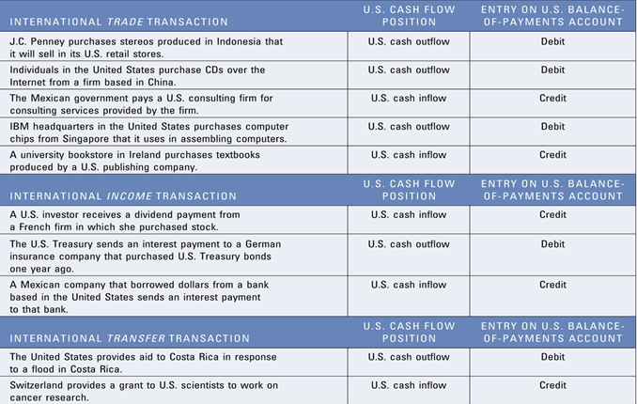


Slide 7
The Current Account
Divided into four finer categories:
  Goods trade represents exports and imports of tangible goods (e.g., oil, wheat, clothes, automobiles, computers, etc.)
  Services include payments and receipts for legal, consulting, financial, and engineering services, shipping fees, and tourist expenditures
  Primary income consists largely of payments and receipts of interest, dividends, and other income on foreign investments that were previously made
  Secondary income involves “unrequited” payments (aids and grants)
3-<number>

Slide 8
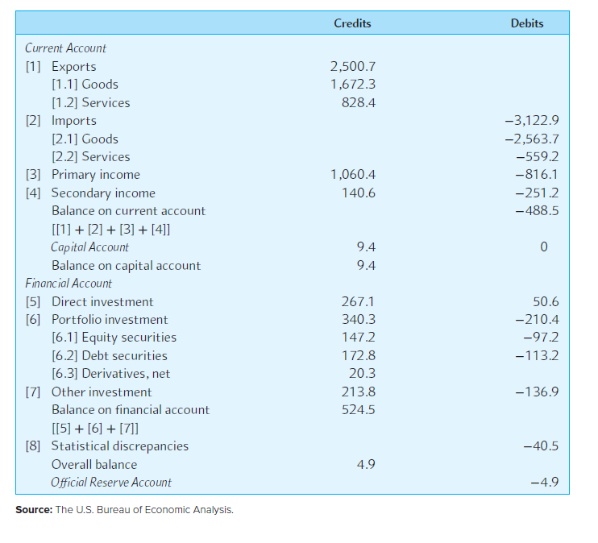
Summary of the U.S. Balance of Payments for 2018 ($b)
3-<number>

Slide 9
The Current Account balances in US
Q3 2025 = -$226 B
Q2 2025 = -$249 B
https://tradingeconomics.com/united-states/current-account
https://www.bea.gov/data/intl-trade-investment/international-transactions
3-<number>

Slide 10
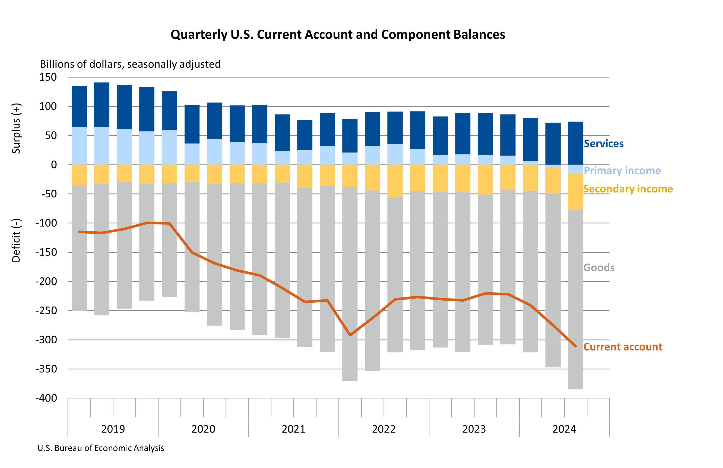

Slide 11
The Current Account (Continued)
Current account balance, especially the trade balance, tends to be sensitive to exchange rate changes
  Currency depreciation or devaluation can improve the trade balance if imports and exports are responsive
3-<number>

Slide 12
The Current Account (Continued)
  If currency depreciates (USD), and if imports are responsive to price changes, then US consumers switch to domestic alternatives (instead of imports. Since imports become more expensive), this improves trade balance immediately.
  If currency depreciates, demand for exports increases as goods exported become less expensive. This improves the trade balance too.
3-<number>

Slide 13
The Current Account
Currency depreciation or devaluation can worsen the trade balance if imports and exports are inelastic
J-curve effect refers to the initial deterioration and eventual improvement of trade balance following the depreciation of a country’s currency
If currency depreciates, and imports are inelastic to price changes, then US consumers may not switch to domestic products immediately since its difficult to change consumption behavior in a short notice. Consumers purchase imports at higher prices. Even if consumers want to switch to domestic alternatives, the alternatives may not be available immediately. Or they may have entered into forward contract.
3-<number>

Slide 14
Other factors that affect international trade
Cost of labor – cheap labor in other countries
Country’s Inflation rate relative to other countries it trades.
National income – Foreign Consumption increases
Credit conditions – tight when economic condition weakens.

Slide 15
Other factors that affect international trade…continued
Government policies (to increase exports and improve balance of trade)
  Restrictions on import
  Subsidies for exporters
  Restrictions on Piracy
  Environmental restrictions (high cost)
  Labor laws
  Business law
  Tax breaks
  Country trade requirements – forms and licenses cause delays
  Government ownership or subsidiaries
  Country security

Slide 16
The Capital Account
Capital transfers, acquisitions, disposals of non-produced non-financial asset between US residents and foreigners.
Examples: Natural resources such as land, mineral rights, air space, contracts, licenses, leases, non-life insurance claims, etc.
  Example: US purchases foreign trademark; US purchases drilling rights to an overseas location; etc.
3-<number>

Slide 17
The Financial Account
Measures the difference between U.S. sales of assets to foreigners and U.S. purchases of foreign assets
Can be divided into three categories:
  Foreign direct investment (FDI) occurs when the investor acquires a measure of control of the foreign business.
  Portfolio investment mostly represents sales and purchases of foreign financial assets, such as stocks and bonds.
  Other investment includes transactions in currency, bank deposits, etc.
3-<number>

Slide 18
Statistical Discrepancy
Exhibit 3.1 shows a statistical discrepancy of -$40.5 billion in 2018
  Omitted or mis recorded transactions
  Recordings of payments/receipts arising from international transactions are done at different times and places, possibly using different methods
  Financial transactions may be mainly responsible for discrepancy
Overall balance is the cumulative balance of payments including the current account, capital account, financial account, and the statistical discrepancies
3-<number>
Notes:
Exhibit 3.1 is shown on Slide 6.

Slide 19
The Official Reserves Account
Official reserve account includes transactions undertaken by the authorities to finance the overall balance and intervene in foreign exchange markets
International reserve assets comprise:
  Gold
  Foreign exchanges
  Special drawing rights (SDRs) – interest bearing reserve created by IMF.
3-<number>

Slide 20
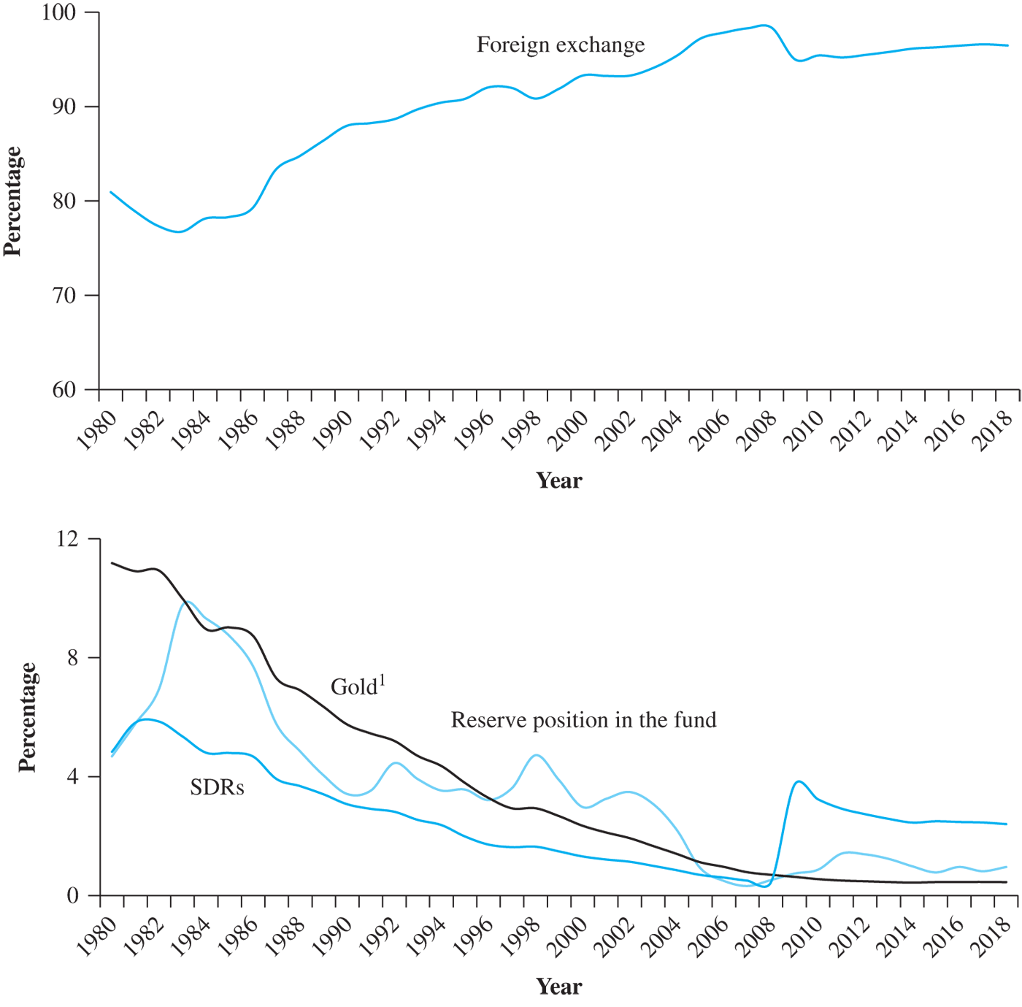
Official reserve account

Slide 21
The Balance of Payments Identity (BOPI)
BCA + BKA + BFA + BRA = 0
where
  BCA = balance on current account
  BKA = balance on capital account
  BFA = balance on financial account
  BRA = balance on the reserves account
3-<number>

Slide 22
BOP Trends in Major Countries
U.S. has experienced continuous deficits on the current accounts since 1982 and continuous surpluses on the financial account; with the sole exception of 1991
  Magnitude of U.S. current account deficits is far greater than any that other countries ever experienced during the 36-year sample period
Japan has had an unbroken string of current account surpluses (and financial account deficits) since 1982 even though the value of the yen rose steadily until the mid-1990s
3-<number>

Slide 23
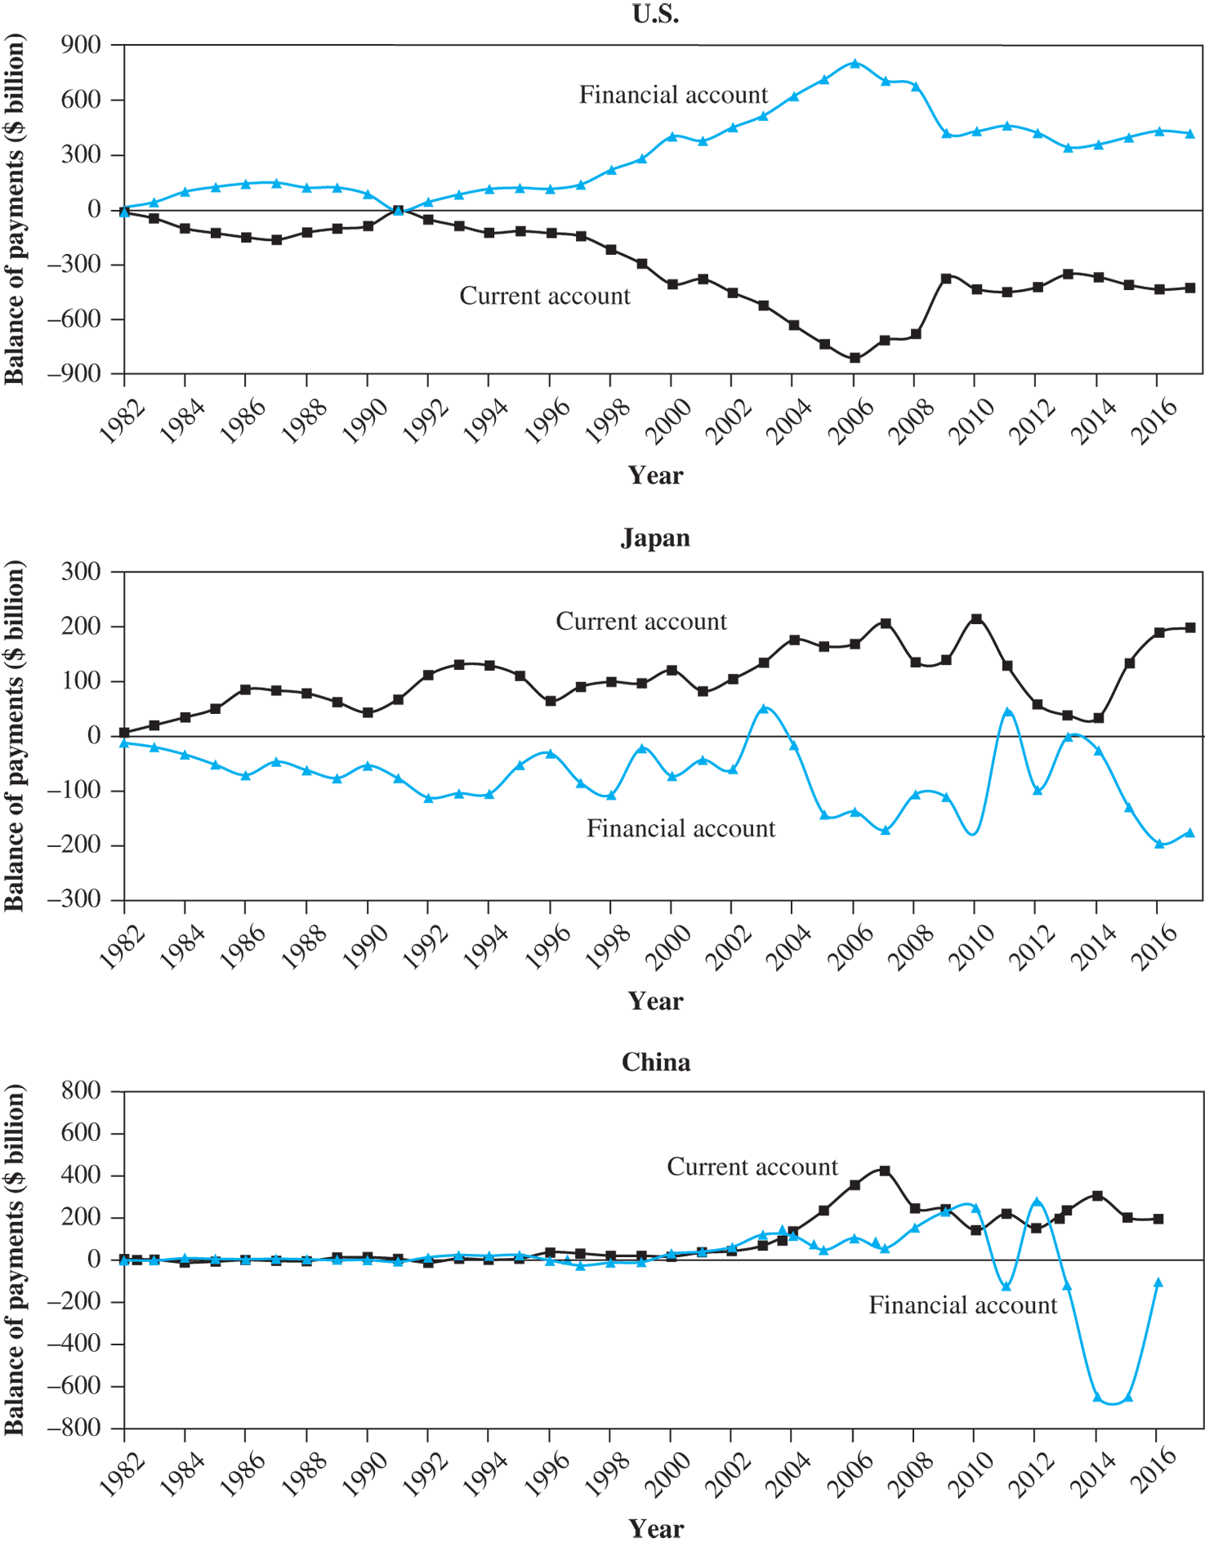

Slide 24
Factors that appreciate/depreciate currency
Inflation Rates: Increase in U.S. inflation leads to increase in U.S. demand for foreign goods, and an increase in U.S. demand for foreign currency, hence dollar depreciates.
Interest Rates: Increase in U.S. interest rate leads to increase in increase in US investments and hence dollar appreciates.
Real GDP: increases exports and hence causes the dollar to appreciate.
Income Levels: Increase in income levels increases demand for foreign goods, hence dollar depreciates.
  Government controls: Imposing foreign exchange or trade barriers, Intervening in foreign exchange markets; affecting macro variables such as inflation, interest rates, and income levels.

